Slide 1
Renaissance, Reformation, & Discovery
The incredible age from 1450 to 1599

Slide 2
Renaissance The rebirth of classical thought processes and values
Why did it occur in Italy?
Geography (Location and Shape)
Political Climate
Cultural Heritage
Wealth and Talent become more important than family background.
Cultural Diffusion – the spread of ideas from their source due to the exchange with traders or travelers.

Slide 3
The Development of Art
Improvements in Metalwork
Money
Clocks
Printing Press ~ Johann Gutenberg
Improvements in Art Technology
Oils, Tempera, Surfaces, Brushes, Techniques
Patronage – we pay artists to create
Madrigal – folk songs performed in parts by traveling minstrels
Sonnet – a 14-line poem with a specific rhyme scheme, usually about love

Slide 4
The Development of Art
Improvisation – the ability to use one’s talent in an extemporaneous way
Autobiography – the story of one’s own life and actions
Chateaux – elaborate small castles in South France along the Loire River
Mannerism – a post-Renaissance art style that exaggerated Renaissance characteristics
Baroque – a very elaborate, ornate, and sometimes unusual artistic style

Slide 5
Political Developments
Exploration ~ the discovery and development of new sources of materials and ideas
Balance of Power ~ Attempt to equal out the “sides” on which Italian city-states allied themselves
Courtier ~ An accomplished negotiator, sent to rival city-states to influence the actions of the Signore
Diplomacy ~ The act of talking nicely to one’s enemies while stabbing them in the back
Divine Right of Kings ~ The belief that God has decreed who will have power over others, and gives them the right to rule as they wish
Absolutism ~ System in which the Monarch’s word is law, and must never be questioned by their subjects

Slide 6
The Hundred Years War

Slide 7
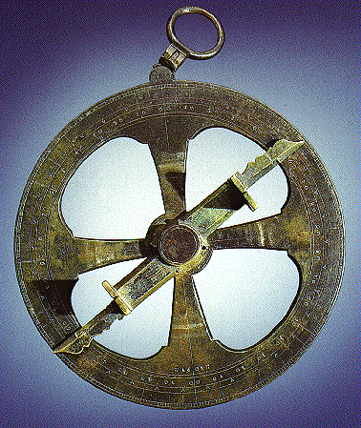
Exploration Technology
Astrolabe – a technical device developed by the Arabs that helped seamen plot their travels by using Latitude and Longitude

Slide 8
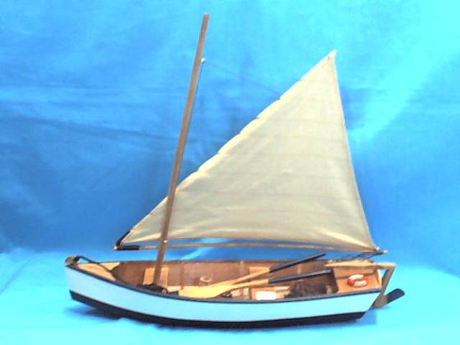
Exploration Technology
Lateen Sail – a triangular-shaped sail that allowed seamen to better catch shifting winds and even sail “into” the winds

Slide 9
Economic Developments
Commerce ~ Trade among nations
Mercantilism ~ The “Golden” Rule
Import ~ incoming goods
Export ~ outgoing goods
Balance of Trade ~ the profitable situation that exists when we have an optimal relationship between imports and exports
Rise of Banks ~ related to the need of monarchs for money to finance wars and exploration. Perfected by Jacob Fugger.

Slide 10
Religious and Philosophical Concepts
Reformation ~ the desire to change aspects of the Church that seemed incorrect
Humanism ~ A belief that “man is the measure of all things”
Vocations – Do all men have “value”?

Slide 11
Religious and Philosophical Concepts
Reformation ~ the desire to change aspects of the Church that seemed incorrect
Humanism ~ A belief that “man is the measure of all things”
Vocations
Abuses of the Church
Inquisition – Trial for the “truth”

Slide 12
Religious and Philosophical Concepts
Reformation ~ the desire to change aspects of the Church that seemed incorrect
Humanism ~ A belief that “man is the measure of all things”
Vocations
Abuses of the Church
Inquisition
Heretics – those who do not believe

Slide 13
Religious and Philosophical Concepts
Reformation ~ the desire to change aspects of the Church that seemed incorrect
Humanism ~ A belief that “man is the measure of all things”
Vocations
Abuses of the Church
Inquisition
Heretics
Indulgences – “Get Out of Hell Free” cards

Slide 14
Religious and Philosophical Concepts
Reformation ~ the desire to change aspects of the Church that seemed incorrect
Humanism ~ A belief that “man is the measure of all things”
Vocations
Abuses of the Church
Inquisition
Heretics
Indulgences
Simony – selling out church offices

Slide 15
Religious and Philosophical Concepts
Counter-Reformation – the Church responds

Slide 16
Religious and Philosophical Concepts
Counter-Reformation
Protestant – those who “protest” against the operations of the Church

Slide 17
Religious and Philosophical Concepts
Counter-Reformation
Protestant
Huguenot – if you live in France

Slide 18
Religious and Philosophical Concepts
Counter-Reformation
Protestant
Huguenot
Puritan – if you’re English, and want your services rid of all Catholic aspects

Slide 19
Religious and Philosophical Concepts
Counter-Reformation
Protestant
Huguenot
Puritan
Evangelist – those who go about and spread the good word to others

Slide 20
Religious and Philosophical Concepts
Counter-Reformation
Protestant
Huguenot
Puritan
Evangelist
Theocracy – when the governmental and religious leaders are the same person

