Slide 1
The Middle Ages
(fall of Rome to 1337 A. D.)

Slide 2
Clovis, King of the franks

Slide 3
Justinian & Belisarius – byzantine powers

Slide 4
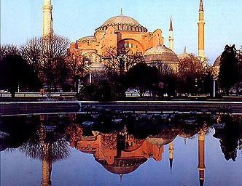

Slide 5
Hagia
Sophia

Slide 6
Mosaic

Slide 7
The age of chivalry
Page – Age 7 - 14
Esquire – Age 14 - 21
Knight – the homage
Knight-errant

Slide 8
Le morte d’arthur

Slide 9
The role of chess

Slide 10
The role of chess

Slide 11
Muhammad & islam

Slide 12
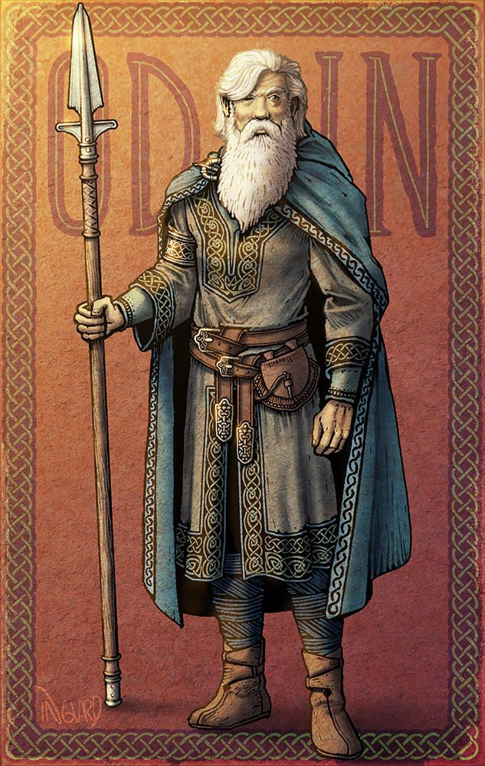
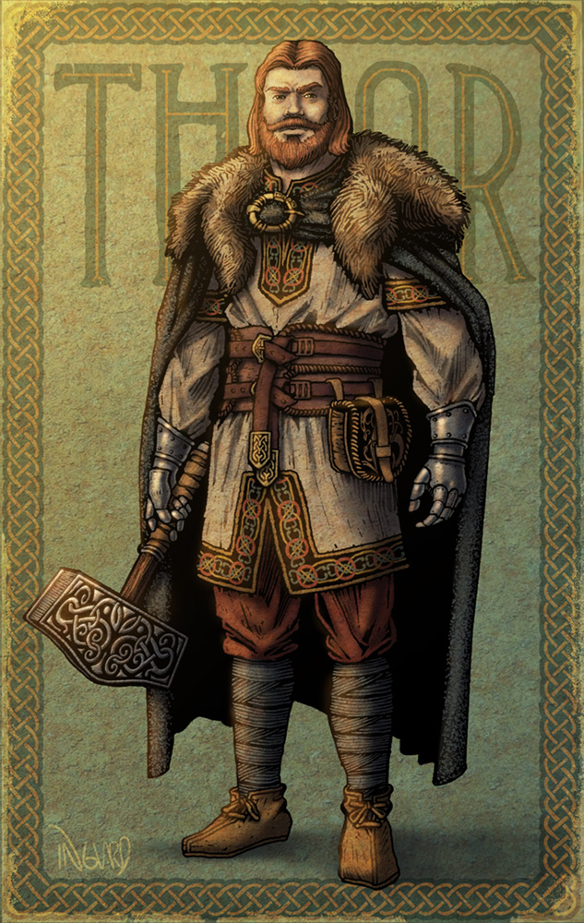
Norse mythology

Slide 13
Druid priests
Lebor Gabála Érenn (an ancient Irish collection of poems and narratives) refers to the Greek Partholon who reached Ireland after the big flood. He came from Macedonia or central Greece with his wife; his three sons and their wives and three Druids, Fios, Eólas, Fochmarc. The names of the three druids mean cognition, κnowledge and inquiry.

Slide 14
Gives: Access to land; Makes laws; Provides judgements; Protects the kingdom Takes: Assistance; Soldiers; Taxes; Food & Services; Absolute loyalty
Gives: Loyalty; Administrative Assistance; Land to Knights; Taxes Takes: Settlement of disputes; Profits; Land from King; Status
Gives: Military service; Local order; Taxes Takes: Land from Noble; Produce from Peasants
Gives: Labor; Food; Products; Services Takes: Protection; Meager leftovers

Slide 15
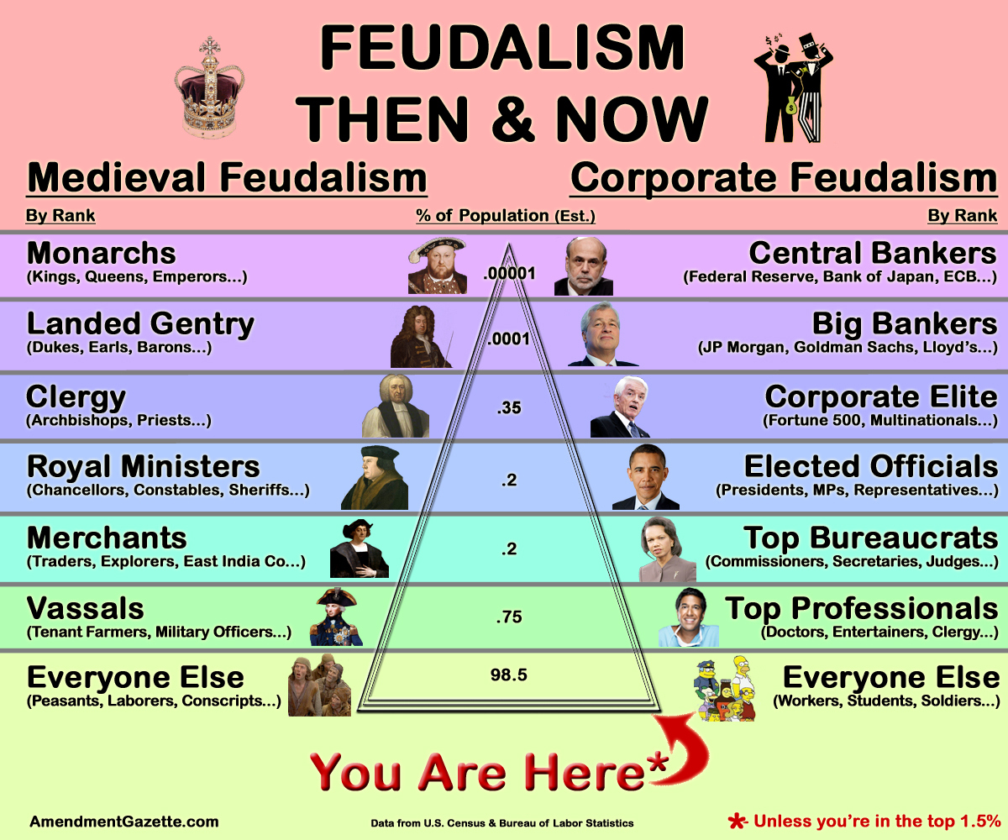

Slide 16
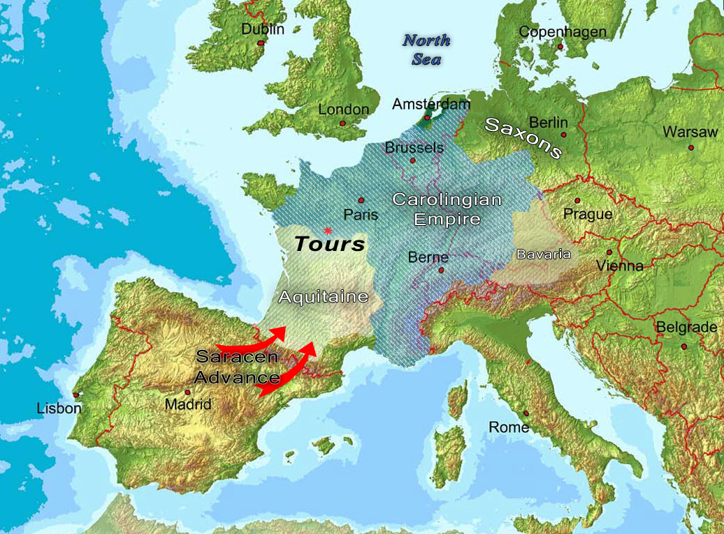
Charles “the hammer” wins the battle of tours

Slide 17
Pepin “the short” bridges a gap

Slide 18
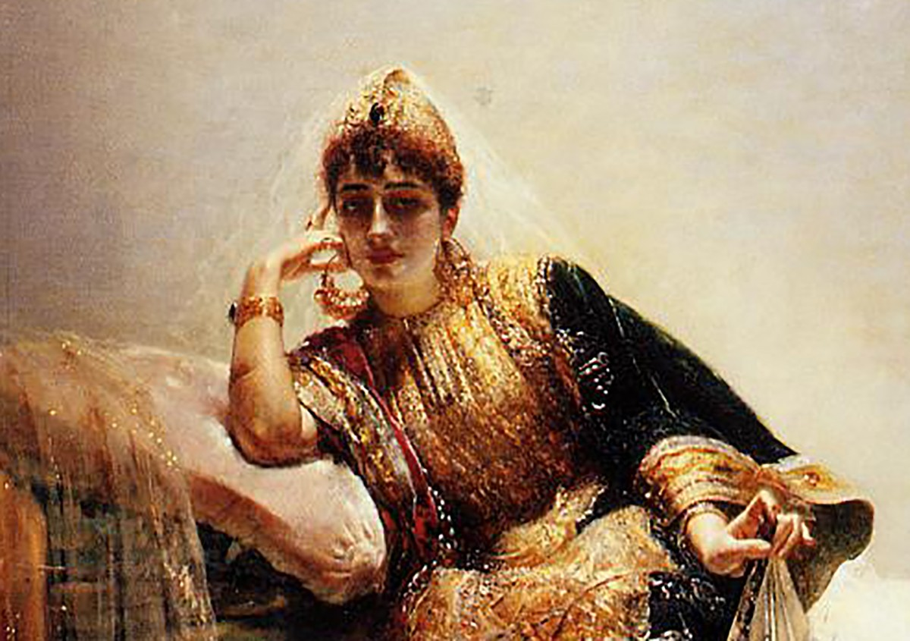
Harun al-rashid & Scheherazade

Slide 19
charlemagne

Slide 20
Machu picchu

Slide 22
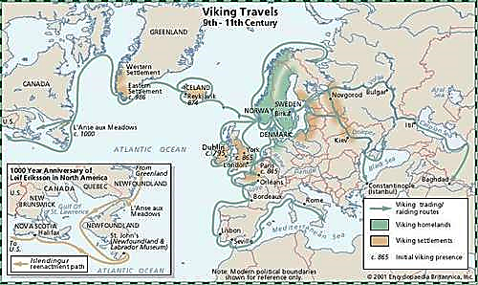

Slide 23
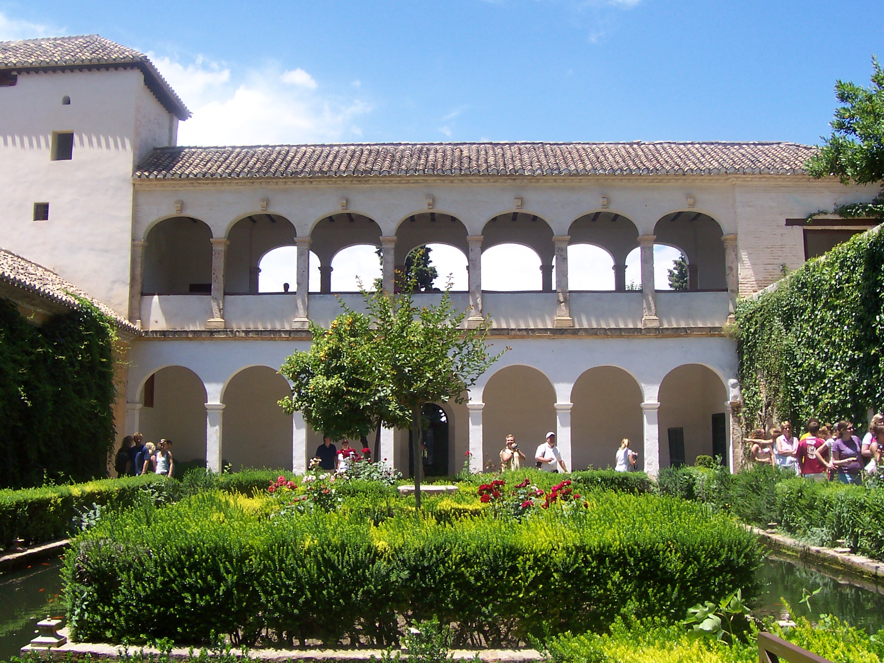
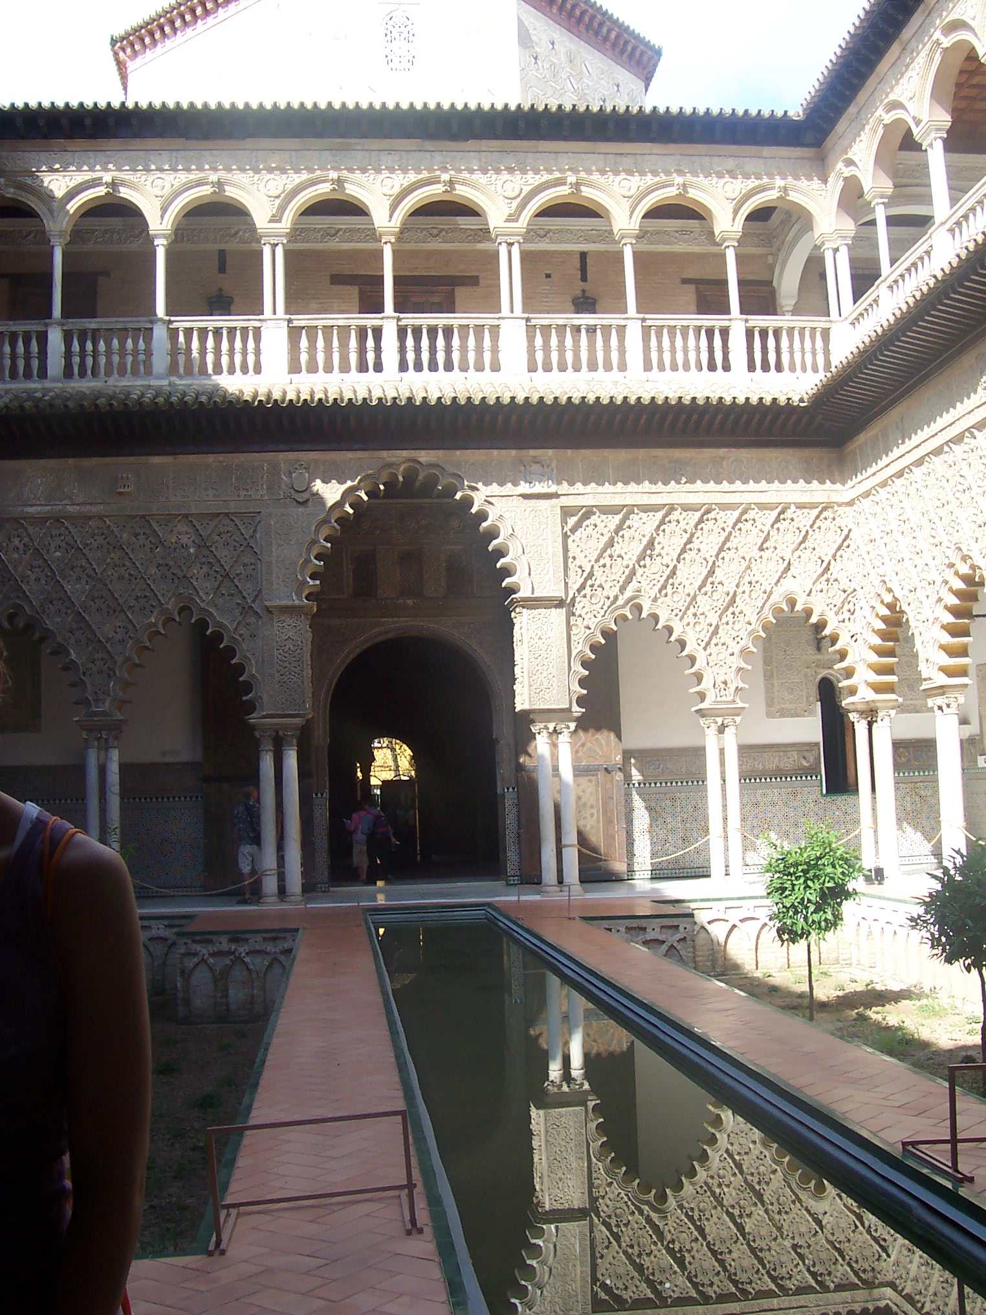
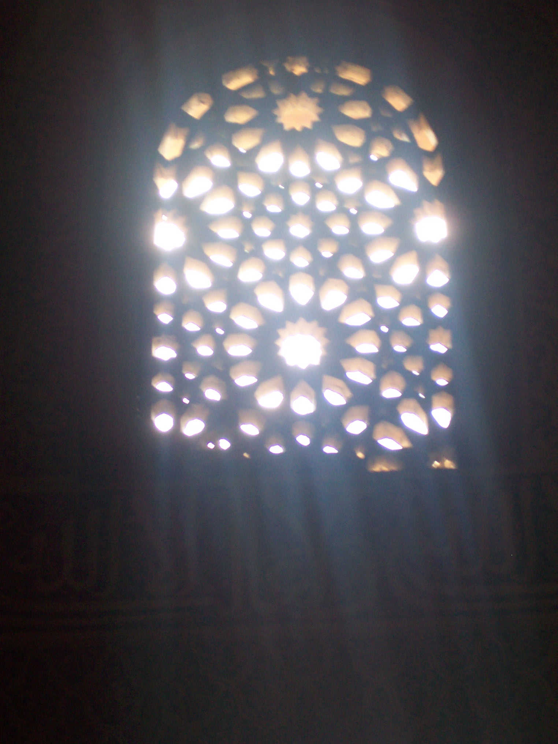
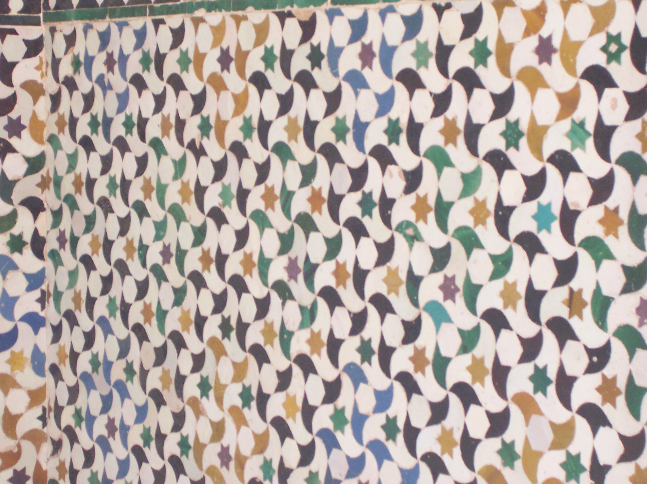

Slide 24
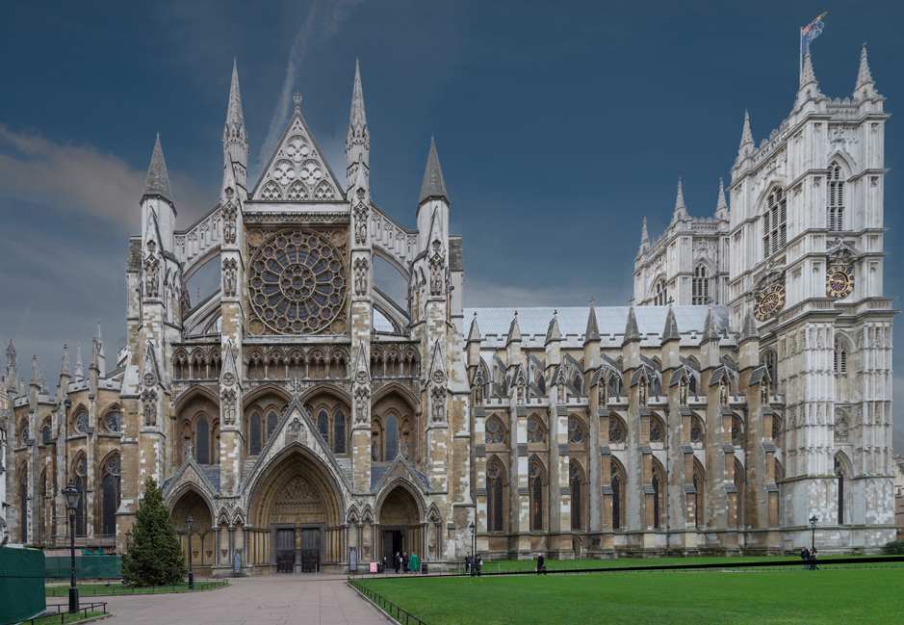
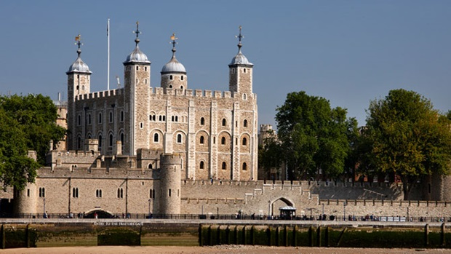

Slide 25
Frederick barbarossa

Slide 26
Henry ii plantagenet & Eleanor of acquitaine

Slide 27
& Thomas á becket

Slide 28
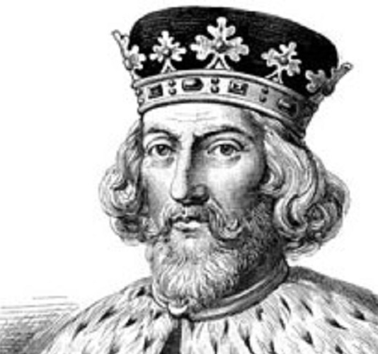
& Richard Coeur de lion & john

Slide 29
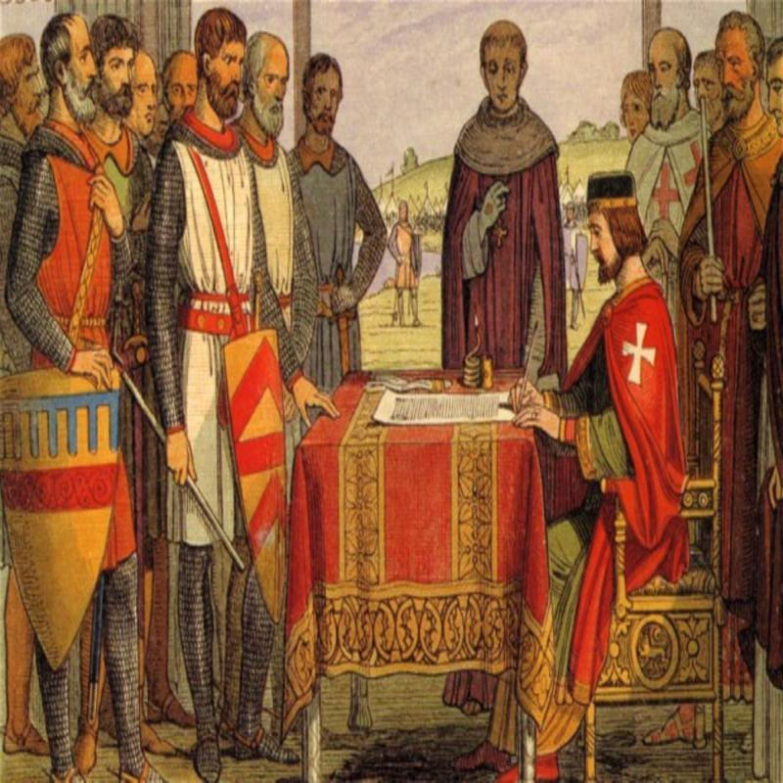

Slide 30
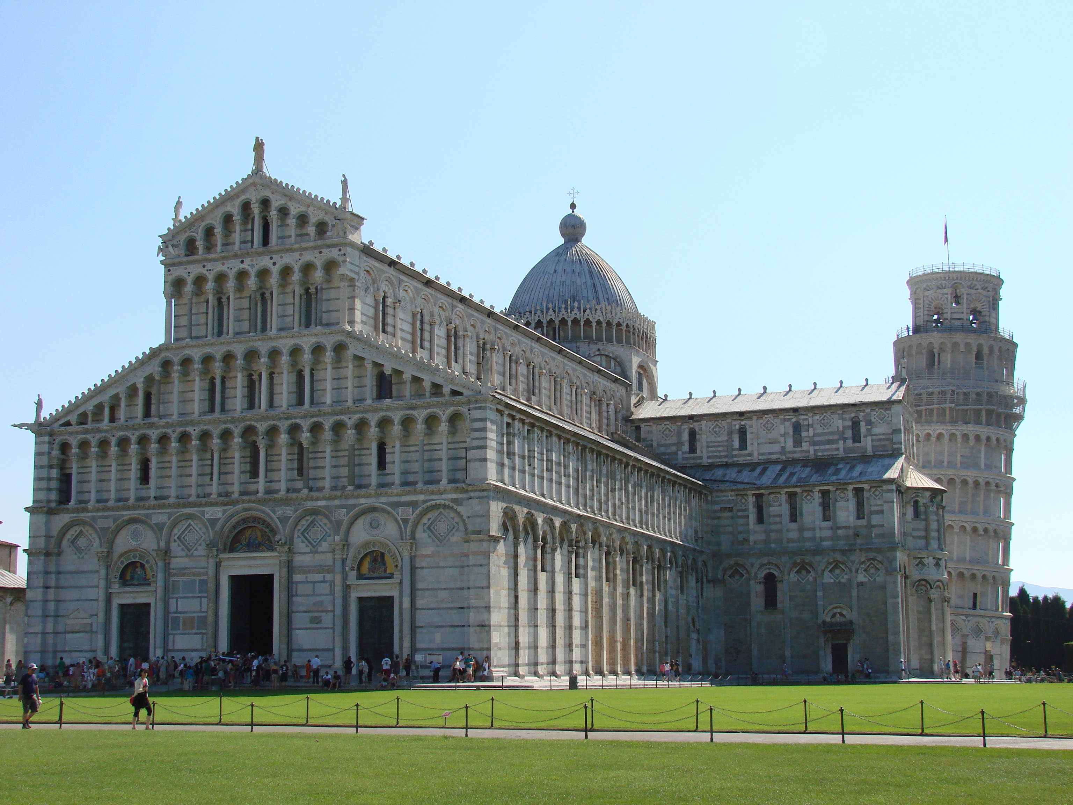
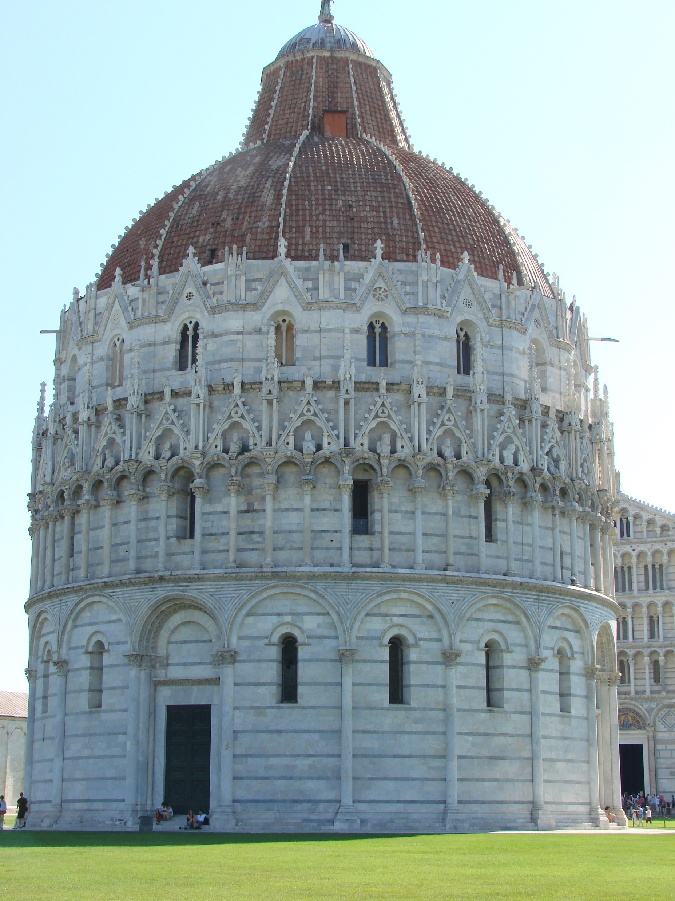
Campanile of pisa

Slide 31
Chartres cathedral

Slide 32
Genghis khan (Temujin)

Slide 33
St. francis of assisi

Slide 34
Alexander nevski

Slide 35
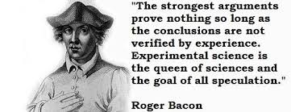
Scientific
Method
Optics
Air
Pressure
Gunpowder

Slide 37
Thomas Aquinas Summa theologica

Slide 38
Dante Alighieri
The Divine Comedy

Slide 39
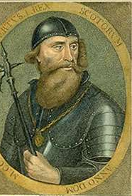
Robert Bruce & William wallace

