Slide 1
Cognition, Language Development, & Intelligence

Slide 2
Elements of Cognition
Conceptualization
Algorithms
Heuristics
Insight
Intuition
Fixation
Notes:
Cognition includes: thinking, knowing, remembering, communicating - Concep. = mental groupings of similar things - Alg. = step-by-step procedures - H. = simplified strategies (cut down the options)

Slide 3
The Fear Factor
p. 225 in your text
Notes:
Messes with our thought processes because we irrationally fear the worst possible outcome. Those fears are based on ancestry (snakes etc.), lack of control, immediate threats, available info.

Slide 4
Framing
How an issue is presented to us…
“10% of patients die during this surgery.”
“Would you rather get a 14 or an 82% on this test?”

Slide 5
How Babies Learn to Communicate
in fantis
Receptive Language
Productive Language
Babbling sounds
Babbling “words”
Single words
Telegraphic speech
Watch out!!!

Slide 6
Theories of Development
Jean Piaget
Stages of Development
Egocentric Speech
Let kids explore
Vs.
Lev Vygotsky
Culture matters most
Language is vital
Experience life with teachers and peers

Slide 7
How People Learn to Communicate
Development of neural networks
Nouns come first
2nd Language skills
Immigrant teenagers?
Hearing impaired folks?

Slide 8
Thinking without words
Our use of visual imagery
Ideas vs. Words
Product Goals vs. Process Goals

Slide 9
What about Non-humans?
Do other species have cognitive skills?
Can they conceptualize?
Video
Do they have language?
What about syntax?

Slide 10
Testing Issues
Achievement
Vs.
Aptitude

Slide 11
Studies in Psychology
Cross-Sectional
Longitudinal

Slide 12
Intelligence
What is your definition?

Slide 13
Intelligence – Mr. Woody
Intelligence is the complex interaction of several specialized abilities that allows humans (and other animals, to differing degrees) to interpret and manipulate information in order to analyze the nature of the problems that we encounter in daily life, evaluate possible solutions to those problems, and create the best solution from that list, or by combining elements of various solutions.

Slide 14
Intelligence - Dictionary
Merriam-Webster Online:
(1) The ability to learn or understand or to deal with new or trying situations: REASON; also: the skilled use of reason. (2) The ability to apply knowledge to manipulate one's environment or to think abstractly as measured by objective criteria (as tests).

Slide 15
How does our definition deal with:
Retardation – Developmental Delay
Down Syndrome
Giftedness
Alterations
Autism
Learning Disabilities
Asperger’s Syndrome
Feral Children
Savants

Slide 16
How would you measure it?

Slide 17
“The IQ test was invented to predict academic performance, nothing else. If we wanted something that would predict life success, we’d have to invent another test completely.”
Robert Zajonc

Slide 18
KEY ELEMENTS OF USEFUL TESTS
Reliability – the degree to which a test is consistent. Will we get the same result time and time again?
Validity – the degree to which the test measures what it is supposed to measure. Content V. is pertinent behavior, while Predictive V. predicts future behavior.

Slide 19
MEASURABLE INTELLIGENCE DIFFERENCES
Fluid – the ability to reason quickly and abstractly
Peaks in our 20’s and declines
Crystallized – accumulated knowledge
Increases throughout life. Leads to gains in vocabulary, clearer decisions, more wisdom

Slide 20
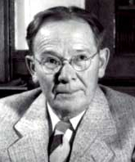
Lewis Terman
Alfred Binet

Slide 21
Binet saw intelligence as a continuum, and attempted to locate students on that scale.
“Some recent philosophers have given their moral approval to the deplorable verdict that an individual’s intelligence is a fixed quantity, one which cannot be augmented. We must protest and act against this brutal pessimism.”
Terman thought intelligence tests could
“ultimately result in curtailing the reproduction of feeble-mindedness and in the elimination of an enormous amount of crime, pauperism, and industrial inefficiency.”

Slide 22
Measuring Intelligence Quotient
A device of William Stern
Chronological Age
Mental Age
Finding a standard measure
MA / CA * 100 = IQ

Slide 23
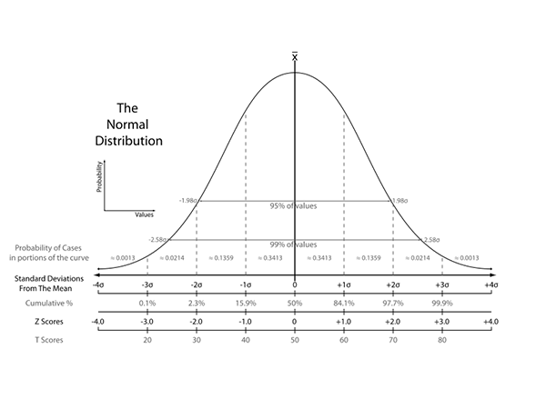
Bell Curve
55
70
85
100
115
130
145

Slide 24
David Wechsler
WISC
WAIS

Slide 26
POTENTIAL PROBLEM AREAS
Cultural Bias
Intellectual Bias
Rising IQ Scores
Hereditary Factors
How I is AI ?

Slide 27
ELDER FACTORS
Alzheimer’s ?? Or…
--------------------------------------------
Income
Level of Education
Stimulating Jobs Held
Intact Family
Cultural Activities
Intelligent Spouse
Flexible Personality

Slide 28
Howard Gardner
“It’s not about
how smart you
you are; it’s
about how you
are smart.”

Slide 29
Howard Gardner
“It’s not about
how smart
you are; it’s
about how you
are smart.”
The Theory of
Multiple
Intelligences

Slide 30
The Multiple Intelligences
Verbal
Numerical
Spatial
Musical
Kinesthetic
Interpersonal
Intrapersonal
Naturalistic
Existential ?

Slide 31
Where does Creativity fit in?
Convergent Thinking
vs.
Divergent Thinking

Slide 32
Where does creativity come from?
Have Expertise
Use Imagination
Be Venturesome
Have Intrinsic Motivation
Good Environment

Slide 33
Can I become more creative?
Develop your expertise
Allow “incubation” time
Take “meditation” time
Seek other cultures and ways of thinking

Slide 34
WHERE DOES CREATIVITY FIT IN?
T. S. Eliot
Albert Einstein
Pablo Picasso
Igor Stravinsky
Martha Graham
Mahatma Gandhi
Sigmund Freud
Charles Darwin
Lao Tzu ?

Slide 35
So, what does that survey thing tell me?
Find two highest numbers
These are your strengths
Find two lowest numbers
These are your weaknesses
Remember: It is NOT a test.
Scores are NOT comparable.
View your results in light of the two biggest requirements for intelligence testing.

